Slide 1
Child Welfare System
By the numbers

Slide 2
Keeping Families Together
Identified Challenges
Disproportionality in every part of the child welfare system
Opportunity to strengthen effective teaming, parent and child voice in decision making
Ensuring proactive solutions as often as possible (rather than reactive)
Avenues of Opportunity
Offerings of prevention services and supports
Child and family teaming – participation of the child, parent and caregiver
Immediate and supported placement with relatives – upfront family finding and immediate family support and services
Avoid unnecessary removals Keep children within their communities and families to avoid greater trauma Improve permanency and well-being outcomes
Indicators of Success
Reductions in referrals, substantiations, and entries into foster care
Increased placement stability
Improved health and mental health outcomes and other indicators of child well-being
Notes:
Frame it as if it’s not CDSS saying it – what problems have stakeholders identified? Challenges we face?

Slide 3
Landscape Map Structure
Prevention Supports:
Child and Family Teaming and Upfront Family Finding:
Emergency Placement and Emergency Caregiver $:
Law requires reasonable efforts to avoid removal + new funding to support prevention.
If removal becomes necessary, child can be immediately connected with relative prior to the relative being approved as a resource family. Emergency Caregiver funding supports child from day of placement.
RFA or Child-Specific Approval.
Child and family voice regarding what is needed to avoid removal, identify family supports including a relative if removal becomes necessary, support family through reunification or other permanency.
Level of Care Funding to Support Youth.
Streamlined Access to Specialty Mental Health Services.
Intensive Services Foster Care:
Specialized Care Increments.
Can support a child without necessitating placement change – kin can be ISFC.
Innovative Models of Care.
Wraparound.
Supportive Services (Kinship Navigation):
2083 MOUs for Service Coordination:
Education Supports and FY Liaisons:
School of origin rights, funding for transportation to school of origin.
Reunification:
Emergency Child Care Bridge, Respite, Support Groups, Classes, Extracurricular.
Education Developmental Services, Health Care, Behavioral Health.
- or - Flexible Approaches to Permanency.
Notes:
This is the structure that exists on paper but often not in reality. It provides a landscape map – the landscape of how we intend to support children within their own family structures from before they are ever removed and throughout their time in foster care.
While there are some gaps in the landscape map itself that need to be addressed through statute or funding – to create new spaces on the board or to address gaps within these different components – the gaps that exist are largely in implementation of all these components to fidelity.
Respite can be included in ISFC, IMC, or wraparound.

Slide 4
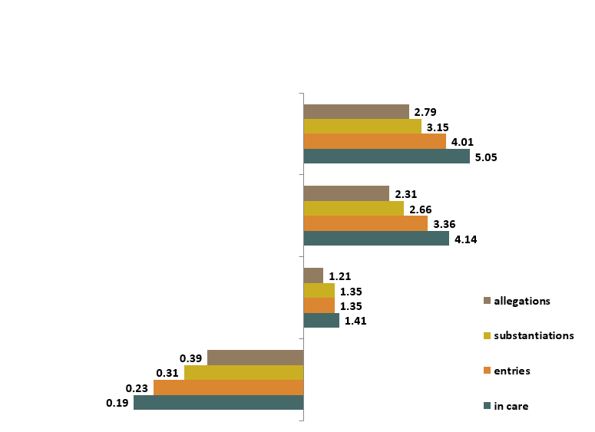
Racial Disparity Indices (General Population) Ethnic Group Disparity Compared with White Children along CW Continuum
Why We Have to Get this Right – Disproportionality Within the Child Welfare System
Black
Native American
Latino
Asian/PI
White

Slide 5
Child and Family Teaming
Key Roles in Attendance | Percent of Meetings (n=99,939)
Child Welfare Social Worker | 88.7%
Bio Mother | 56.3%
Child | 46.9%
Resource Parent | 38.7%
Bio Father | 28.9%
Other Family | 23.9%
Sibling | 12.8%
Data shows us that we have opportunities for more robust involvement and engagement of the parent, child, caregiver and other important family supports
Notes:
WHAT we can change – there are lots of indications that we are not using the tools to their fullest potential.

Slide 6
Level of Care to Support Youth in Family Settings
Placement Type | Basic | Level 2 | Level 3 | Level 4 | ISFC
Foster Family Agency | 62% | 18% | 6% | 6% | 8%
Resource Family Home | 67% | 17% | 5% | 8% | 4%

Slide 7
Why We Have to Get This Right:
Since 2017
53% increase in youth that have a first placement with a relative or extended family member
92% increase in youth whose predominant placement is with a relative or extended family member.
Because Focus on the Child’s Family Works
75% of youth that had their first placement with a relative and are still in care at 12 months are still with that relative
Notes:
What we can hope to achieve
Even without all the components operating as they should – just the structure that is in place, the increased attention to family finding and placement, has resulted in a massive increase in use of relatives and we see in the data how stable those placements are.

Slide 8
Placement with Siblings
73% of children placed with relatives are placed with all of their siblings
51% of children with non-relatives are placed with all of their siblings

Slide 9
Workable Solutions: Keeping families together
Family Engagement
Family Support
Data informed

