Slide 1
Pre-Vocational Foundational Skills Development
Provision of Community-Based Pre-Vocational Foundational Skills Development in the LPA
Notes:
Hello, I am Elizabeth Mard from the Department of Developmental Services and I will be presenting a training about resources for Pre-Vocational Foundational Skills Development.

Slide 2
Local Partnership Agreement (LPA) Training
Pre-Vocational Foundational Skills Development
Presented by:
California Department of Education
California Department of Rehabilitation
California Department of Developmental Services
Notes:
This training was developed by the Competitive Integrated Employment Blueprint Team including the California Department of Education, California Department of Rehabilitation and the California Department of Developmental Services with the input of various stakeholders.
The training is divided into seven sections including:
How can LPAs help increase Pre-Vocational Skills?
What are the Challenges of Gaining Pre-vocational Foundational Skills for Individuals with ID/DD?
Keeping families informed of the ways they can help
What can Schools do?
What does DOR offer?
What does DDS offer?
Other Pre-vocational Foundational Skills Resources
Throughout the presentation I will be using the term an individual with ID/DD to refer to an individual with an intellectual disability and a developmental disability and I will be using the abbreviation CIE to refer to competitive integrated employment. Links to the several resources listed in this training can be found on the California Health and Human Services’ CIE webpage under ?LPA training Links?

Slide 3
How can LPAs help increase Pre-Vocational Skills?
LPA core partners including the Local Education Agencies (LEAs), the Department of Rehabilitation Districts (DOR) and regional centers have many resources within their agencies as well as without. The next slides will present information on some of these resources including natural resources.
Notes:
LPA core partners including the Local Education Agencies (LEAs), the Department of Rehabilitation Districts (DOR) and regional centers have many resources within their agencies as well as without. The next slides will present information on some of these resources including natural resources. And, of course, it is encouraged that the partnership coordinate to ensure that these resources and supports are shared with the partnership members and individuals with ID/DD and their support network.

Slide 4
What are the Challenges of Gaining Pre-vocational Foundational Skills for Individuals with ID/DD? (1 of 2)
Lowered expectations from family, school, and community
due to fears pertaining to an individual’s:
Safety (physical, emotional, mental)
Capacity to learn pre-vocational foundational skills
Community support system being reliable
Potential reduction or loss of benefits
Notes:
What are some of the Challenges of Gaining Pre-vocational Foundation Skills for individuals with ID/DD.
Well to start off, Pre-Vocational Foundational Skills are the basic skills most individuals without developmental disabilities learn with the expectation that one day the individual will live and thrive independently. These skills are typically imparted by an individual’s parents, our various education systems, community, and some employment opportunities
For an individual with disability these expectations can be lowered due to the severity of the individual’s disability combined with the fears and reservations of their family, their school and their community increasing the hurdles an individual will need to surmount to gain competitive integrated employment. The most common fears and reservations are:
Lack of safety skills to protect themselves in their community. These skills may include public safety awareness, public transportation, self advocacy, and interpersonal skills.
Lack of financial skills including money management, budgeting, and losing their Supplemental Security Income (SSI) and Medi-Cal if they gain employment.
The fear that an individual cannot learn the above listed skills plus the necessary skills to gain and retain competitive integrated employment.

Slide 5
What are the Challenges of Gaining Pre-vocational Foundational Skills for Individuals with ID/DD? (2 of 2)
Ways to overcome these fears and reservations
Help families and individuals with disabilities understand:
The benefits of CIE
How to prepare for CIE by including this as a goal in their Individualized Education Plan/Transition Plan (IEP) and their Individual Program Plan (IPP)
The various resources that support a future in CIE such as supported employment and personal job coaches
Benefit management supports such as: DOR’s Work Incentive Planners (WIPs), Disability Benefits 101, and Achieving a Better Life Environment (ABLE)
Notes:
What are some of the ways to overcome these fears?
Help families and individuals with disabilities understand:
The available resources and the positive outcomes of CIE.
How family members can assist in building the necessary building blocks to this future and how they can take advantage of the various free resources to support them in this endeavor including but not limited to their child’s: Early Start Program, Individualized Education Plan and their child’s regional center’s Individual Program Plan.
Inform the individual and their family about the various resources including employment support services, job coaches, post secondary education etc.. that will help the individual learn job skills and find and retain employment.
Help them understand the financial supports including, but once again, not limited to the Department of Rehabilitation’s Work Incentive Planners, the Disability Benefits 101 website and savings plans such as Achieving a Better Life Environment (ABLE).

Slide 6
Keeping families informed of the ways they can help (1 of 3)
Help develop soft skills including:
Following instructions
Interpersonal skills: Being respectful, honest and helpful
Good Communication
Time management
Maintaining a neat and clean personal appearance
Notifying teachers when they are sick, or anyone else expecting to meet with them that day
Notes:
Keep families informed Inform of the ways they can help.
One of the most basic and important skills that everyone needs to learn before they can find and retain employment are soft skills many of which are taught by parents.
Soft skills consist of many common everyday behaviors that help everyone work together such as:
Following instructions
Learning to work with others
Interpersonal skills, being respectful, honest and helpful
Communications skills
Time management
Organization
Maintaining a neat and hygienic personal appearance
Being responsible when they are sick by notifying teachers, or anyone else expecting to meet with them that day

Slide 7
Keeping families informed of the ways they can help (2 of 3)
Help develop soft skills including: (continued)
The ability to communicate emergency information and carry personal identification.
Attendance - being on time
Advocating – teaching an individual to speak up if they do not like something or if they want or need something
Practicing good home and public safety habits
Using public/specialized transportation or developing independent transportation such as walking, biking, or driving
Notes:
Other examples are:
The ability to communicate emergency information and/or carry personal identification at all times.
Reliable attendance - being on time.
Advocating – teaching an individual to speak up if they do not like something or want or need something.
Practicing good home and public safety habits.
Using public transportation/specialized or developing independent transportation such as walking, biking, driving and the list goes on

Slide 8
Keeping families informed of the ways they can help (3 of 3)
Contact a Family Resource Center (FRC):
FRCs offer resources for:
Individualized Education Program (IEP) Guidance
Health Care & Mental Health Information
Teen Transition to Adult Life
Advocacy Information
Parent and Community Support and Training and much more
Visit the Family Resource Centers Network of California website.
Notes:
Besides assisting with developing an individual’s soft skills and attaining support from an individual’s school or regional center, families can also contact their nearest Family Resource Center which offers free support and resources including:
Family Support & Mentoring
Individualized Education Program (IEP) Guidance
Health Care & Mental Health Information
Teen Transition to Adult Life
Advocacy Information
Parent and Community Support and Training
... and MUCH MORE, at no charge
Be sure to incorporate your local Family Resource Centers into your LPA. They have information for you and LPAs have great resources and information them.
To find the Family Resource Centers in your community visit the Family Resource Centers Network Of California website

Slide 9
What can schools do? (1 of 4)
Pre-vocational skills can be added as a goal to an individual’s IEP at any age such as:
Critical thinking
Communication
Teamwork
Citizenship
Integrity, and ethical leadership
Research techniques
Creativity and innovation
Notes:
How can schools prepare an individual for future employment?
Schools can assist in incorporating pre-vocational skills development into an individualized education plan (IEP) at any age.
These pre-vocational skills are other soft skills such as:
Critical thinking
Verbal and written communication
Teamwork
Citizenship
Integrity, and ethical leadership
Research techniques
Creativity and innovation and many other soft skills as well as job skills and job experience.
Local education agencies can offer various transition services for individuals to prepare for or move into CIE, such as:
WorkAbility I (WAI), the Transition Partnership Programs (TPP) and, the Paid Internship Program (PIP) and other transition planning resources that include prevocational skills and vocational supports.

Slide 10
What can schools do? (2 of 4)
The WorkAbility I (WAI) program provides:
Comprehensive pre-employment skills training
The opportunity to complete secondary education while also obtaining marketable job skills
Job-seeking and job-keeping skills
Occupational class training
On-the-job subsidized or unsubsidized work experience
To find a local WAI visit the WorkAbility webpage on the California Department of Education website
Notes:
The WorkAbility program is funded and administered by the California Department of Education. The WAI program provides comprehensive pre-employment skills training, employment placement and follow-up for high school students in special education who are making the transition from school to work, independent living, and postsecondary education or training. Program services are appropriate to individual student needs, abilities, and interests
The WorkAbility I (WAI) programs can provide:
Comprehensive pre-employment skills training
The opportunity to complete secondary education while also obtaining marketable job skills
Job-seeking and job-keeping skills
Occupational class training
On-the-job subsidized or unsubsidized work experience
While these programs are in most school district areas, they are not it all. For more information and to find the nearest WAI
visit the WorkAbility I webpage on the California Department of Education’s website

Slide 11
What can schools do? (3 of 4)
Transition Partnership Program (TPP)
TPPs provide:
Coordinated vocational services including DOR Student Services
Employment preparation
Job development
Short-term support services to successfully transition students with disabilities into meaningful employment
Visit DOR’s TPP webpage.
Notes:
Transition Partnership Programs (TPP) are administered through third-party cooperative agreements with select Local Education Agencies (LEAs) and the Department of Rehabilitation (DOR). Statewide, there are approximately 104 TPPs.
TPPs provide enhanced, coordinated vocational services including DOR Student Services and employment preparation, job development, and short-term support services to successfully transition students with disabilities into meaningful employment. For more information visit DOR’s TPP webpage.

Slide 12
What can schools do? (4 of 4)
The Paid Internship Program (PIP)
PIPs offer opportunities for a student to become more informed about their:
Employment preferences
Job skills
What job skills they will need more training or support for
Notes:
Students ages 18-22 years of age, who are interested in participating in the paid internship, may be eligible for the Paid Internship Program.
The PIP is a program funded by the Department of Developmental Services (DDS) to increase competitive integrated employment (CIE) for individuals with a disability. The student’s school and regional center can work together to determine eligibility. The purpose of the PIP is to increase the vocational skills by acquiring experience in paid employment with or without the support of a job coach. Students who choose to participate will have the opportunity to learn about their employment preferences, and what job skills they have and will need more training for and what supports they will need to succeed in CIE.

Slide 13
What does the Department of Rehabilitation offer? (1 of 2)
Student Services
Job Exploration Counseling
Work-Based Learning Experiences
Postsecondary Enrollment Counseling
Workplace Readiness Training
Self-Advocacy Training
To learn more about DOR’s Student Services visit DOR’s Student Services webpage
Notes:
What pre-vocational skills does the Department of Rehabilitation or DOR offer?
The DOR offers Student Services which a student (between the ages of 16 and 21) can attain by making a request at their school or contacting DOR directly.
Student Services include:
Job Exploration Counseling
Work-Based Learning Experiences
Postsecondary Enrollment Counseling
Workplace Readiness Training
Self-Advocacy Training
The DOR, with Local Education Agencies, works with students and families to ensure these employment transition services are available to students with disabilities throughout the state.
To learn more about DOR’s Student Services visit DOR’s Student Services webpage

Slide 14
What does the Department of Rehabilitation offer? (2 of 2)
Achieving Community Employment (ACE) Team
ACE provides career counseling and information and referral services (CC&IR) by offering information on:
Self-advocacy
Self-determination
Peer mentoring resources
Employment training opportunities available in an individual’s local area
Visit DOR’s CC&IR webpage to learn more.
Notes:
Another pre-vocational service DOR offers is the Career Counseling and Information and Referral services otherwise know as CC&IR through their Achieving Community Employment Team, the ACE Team.
The ACE Team provides these services to all individuals with a significant disability and employed at subminimum wage and known to DOR. They also provide this to all youth under 25 years of age including information about federal and state employment and support programs that can help an individual discover, experience, find, and keep CIE.
Visit DOR’s CC&IR webpage to learn more.

Slide 15
What do Regional Centers offer? (1 of 2)
The Paid Internship Program offers:
Employment experience
Job skill assessments and training
Minimum wage and above
Opportunities to learn about earned income
Visit DDS’s website to learn more about PIP
Notes:
What do regional centers offer?
Regional centers can offer a paid internship program (PIP) for anyone 18 years and older.
The purpose of PIP is to increase the vocational skills and abilities of consumers who choose, via the Individual Program Plan (IPP) process, to participate in an internship.
The goals of this program includes the acquisition of skills for future paid employment, or for the internship itself to lead to full- or part-time paid employment.
The PIP pays all wages and payroll costs up to $10,400 a year.
These internships offer
Employment experience
Job skills training
Opportunities to learn how to manage earned income and public benefits.
And last, but not least, PIPs have opened doors to employment opportunities that were not commonly open to individuals with ID/DD
Visit DDS’s website to learn more about PIP

Slide 16
What do Regional Centers offer? (2 of 2)
Supported Employment Program
Job skill assessments
Work experience in integrated settings
Job coach support and training in soft skills, job skills and employment advocacy
Tailored Day Services
Postsecondary education or vocational training
Volunteer activities
Supported employment
To learn more about Supported Employment and Tailored Day Services visit DDS’s Supported Employment and Tailored Day Services webpages.
Notes:
The regional centers Supported Employment Program can offer job skill assessments, training and work experience in various integrated settings with the support of a job coach helping an individual to learn soft skills, job skills, and employment advocacy skills.
Regional centers also offer Tailored Day Services which are designed to maximize a consumer's individualized choices and needs, with customization of day services through individualized services. Tailored Day Services provide opportunities for increased integration and inclusion, as well as opportunities for an individual to develop or maintain employment/volunteer activities and pursue postsecondary education. Tailored Day Services can be utilized for developing vocational skills and gaining employment experience while participating in other areas of Tailored Day Services such as community integration.
It is suggested an individual with ID/DD work with their regional center to learn more about these services.
To learn more about Supported Employment and Tailored Day Services visit DDS’s Supported Employment and Tailored day services webpages.

Slide 17
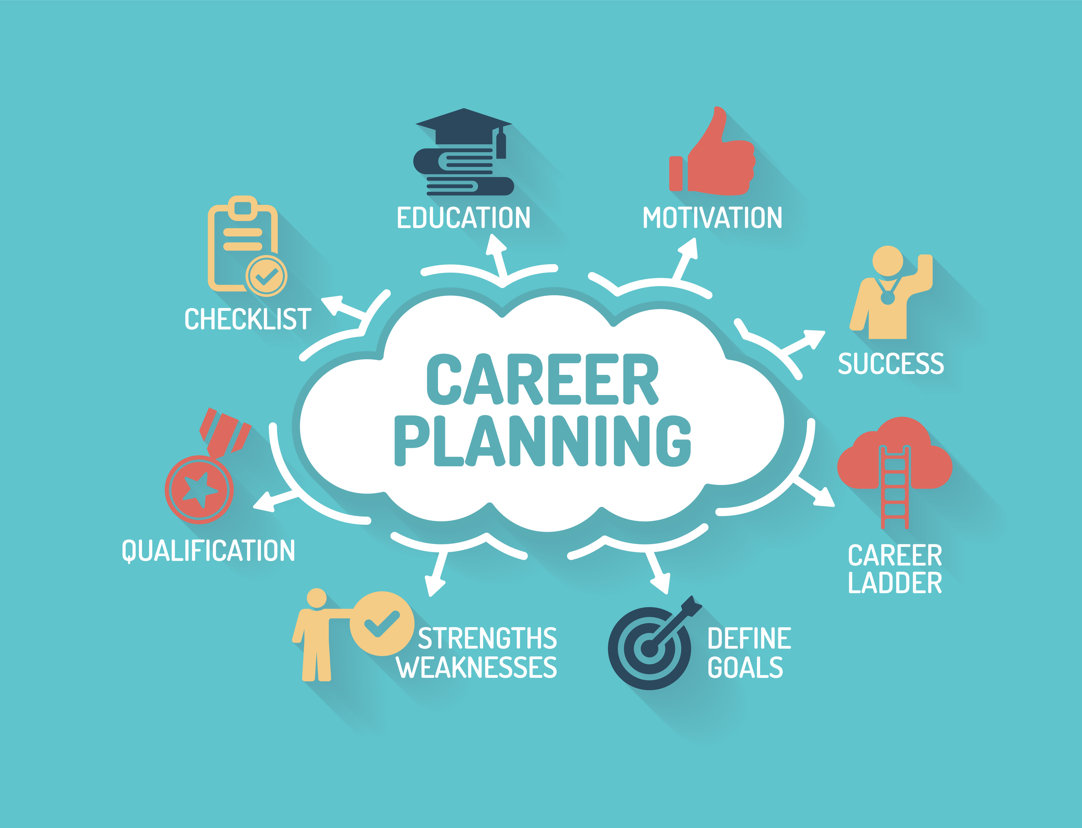
Other Pre-Vocational Resources (1 of 3)
The California Career Zone
includes tools to:
Assess a student’s interests, skills, and work values
Explore and compare occupations
Assist students contemplating college or career
For more information visit the California Career Zone webpage.
Notes:
On to Other Pre-Vocational Resources
The California Career Zone is a website where a student, at any age, can take an assessment to determine their interests, skills and work values. It offers opportunities for the students to explore and compare occupations and learn what skills and education are required to pursue the occupations. It also assists the student in developing a plan and documenting their plan.
For more information visit the California Career Zone webpage.

Slide 18
Other Pre-Vocational Resources (2 of 3)
College to Career (C2C) offers:
Career exploration
General college classes aligned with an individual’s career goals
Internships
Job placement
Project SEARCH Transition-to-Work Program (Project SEARCH)
Classroom instruction
Career exploration
Hands-on training and more
Contact your local community colleges to see if they have a C2C program and for more information about Project Search visit their website.
Notes:
Another one is the College to Career (C2C)
College to Career is a three-year program for students with intellectual disabilities who are consumers of the Department of Rehabilitation (DOR).
College to Career creates and promotes career and technical education opportunities leading to gainful employment for students with ID/DD and/or autism in postsecondary education.
College to Career offers Student career exploration classes during the first program phase. In the second phase, they take general college classes aligned with their career goal followed by internships and job placement in the third phase.
Contact your local community colleges to see if they have a C2C program.
Some known colleges offering this program include College of Alameda, Sacramento City College, Fresno College, Shasta College, West Los Angeles College, Santa Rosa Jr. College, and San Diego County Community College District.
Then there is the Project SEARCH Transition-to-Work Program (Project SEARCH)
Project SEARCH is a unique, business-led, one-year employment preparation program that takes place entirely at the workplace, such as a hospital, in which total workplace immersion facilitates a seamless combination of:
Classroom instruction
Career exploration
Hands-on training and more
For more information about Project Search visit their website.

Slide 19
Other Pre-Vocational Resources (3 of 3)
The California Competitive Integrated Employment Blueprint Toolkit
Competitive Integrated Employment Roadmap for Consumers
CIE Webinar – Pathways to “Real Work for Real Pay in the Real World” Interpreted in ASL and Spanish
Information about:
Services and Supports to Get Ready for CIE
How CIE Changes a Person’s SSI Income and Their Medi-Cal
Community and Transportation Safety
Benefits Planning
Notes:
And last but not least The Competitive Integrated Employment Blueprint Webpage has several resources to introduce individuals with ID/DD and their families. These resources include a Toolkit which contains:
A Competitive Integrated Employment Roadmap for Consumers
A CIE Webinar titled Pathways to “Real Work for Real Pay in the Real World” with American Sign Language and Spanish interpretation
And user- friendly information about:
Services and Supports to Get Ready for CIE
How CIE Changes a Person’s SSI Income and Their Medi-Cal
Community and Transportation Safety and Benefits Planning including:
• Work and Benefits Questions and Answers
• the Student Earned Income Exclusion Fact Sheet
• SSI Work Incentives Quick View
• The Impairment Related Work Expense (IRWE) Fact Sheet
and much more
Be sure to visit the CIE webpage on the California Health and Human Services Website.

Slide 20
Links to all the aforementioned resources can be found on the
Local Partnership Agreement (LPA) Trainings - Presentation Links
at: https://www.chhs.ca.gov/home/cie/cie-toolkit/
Notes:
Links to all the presented resources can be found on the
Local Partnership Agreement (LPA) Trainings - Presentation Links
at: www.chhs.ca.gov/home/cie/cie-toolkit/

Slide 21
Thank you!
Please visit the California Health and Human Services CIE webpage at www.chhs.ca.gov/cie and select the CIE Toolkit to view all recorded trainings and resources.
Send your questions to
CaliforniaCIE@dor.ca.gov
Notes:
This concludes the Pre-Vocational Foundational Skills Development in the LPA training. To view all LPA recorded trainings and available resources, including all presentation links, please visit the California Health and Human Services CIE webpage at www.chhs.ca.gov/cie and select the CIE Toolkit.
Please send any questions you may have to the CaliforniaCIE@dor.ca.gov email
THANK YOU!

