Slide 1
Pathways to
“Real Work for Real Pay in the Real World”
Webinar for People with Intellectual and Developmental Disabilities and their Families.
California Health and Human Services Agency
California Department of Education
California Department of Rehabilitation
California Department of Developmental Services

Slide 2
Overview for Today’s Webinar
This webinar is being recorded so you can look and listen to it after today.
“Real Work for Real Pay in the Real World” is Competitive Integrated Employment which will be called CIE in this webinar.
Since there are so many people calling in, all phones will be muted.
There will be time to ask questions at the end of each section by typing the question in the webinar question box.

Slide 3
Overview Continued
The presenters will repeat the question out loud then answer the question.
For more information and as a resource you were sent two documents before this webinar:
  CIE Webinar Fact Sheet
  CIE Webinar Glossary of Terms

Slide 4

Presented by the:
California Department of Education
California Department of
Rehabilitation
California Department of Developmental Services
Todays webinar presenters are:
Michael Luna, Michael Clay, Elizabeth Mård, Nina Presmont, Jessica Popjevalo, Maureen McIntyre, Barbara Boyd, Nick Wavrin

Slide 5
Outline for this Webinar
What is CIE and what are the benefits of CIE?
How many people with an intellectual and developmental disability (ID/DD) have a job?
How to get ready for CIE in high school and after high school.
How does CIE affect SSI and Medi-Cal?
Being safe on the job and in the community.
Getting to work – transportation options.
More resources for more information and support.

Slide 6
CIE is “Real Work for Real Pay in the Real World”
What does that mean?
Working for real pay (at least minimum wage or at least the same pay as people without disabilities doing the same kind of job).
In the community with people without a disability.
Getting the same benefits and chances for advancement as the people you work with.

Slide 7
How many people with ID/DD have a job?
California employment rates for people with ID/DD are much lower than people without disabilities. The most recent Employment First Annual Report shows that:
75.7 percent of people without a disability have a job as compared to 13.6 percent of people with ID/DD.
Of the 13.6 percent, many work separated from their community and make less than minimum wage. ¹
¹(State Council of Developmental Disabilities, 2017)

Slide 8

Why is CIE important?
It creates more friendships between people with and without disabilities.
It helps people with ID/DD learn new job skills.
It helps people with ID/DD move out of poverty.
It gives people with ID/DD more ways to help their community.
It gives people with ID/DD the chance to work, play, and live in the community just like everyone else.

Slide 9

Why is CIE good for a person with a disability?
CIE helps a person:
Feel good about themselves.
Stay active.
Have more money to buy things they want and need.
Have enough money to save.
To be more independent.

Slide 10

What are the benefits of CIE for the family?
Increased confidence in family member with a disability.
Pride in individual’s achievement.
Increased household income.
Greater family independence.
Reduction in fear about “What happens when I am no longer here?”

Slide 11

How does CIE make a community stronger?
Makes the lives of people with disabilities better.
Helps everyone learn about and understand people with disabilities.
Creates a community where everyone can live their lives together.
A community becomes more successful.

Slide 12

How do employers benefit?
Employers say that people with ID/DD are great employees because they are:
Reliable and punctual.
Motivated and they lower the turn over rate.
Employee morale improves due to the work setting being more inclusive.
An employer’s business increases because customers support more inclusive work settings.²
²(Journal of Occupational Rehabilitation 2018)

Slide 13
Family Case Scenario – Jane
(1 of 7)
Jane’s sister shares Jane’s employment story:
The role my parents played in assisting Jane achieve CIE was mostly a supportive one, because Jane is most successful when she is feeling supported and loved. They had many fears about how she might be treated, what might happen to her benefits, and if she would truly be able to be successful in a job. While Jane’s strengths were being a hard worker, being precise, enjoying routines, and though she was excited about working, she could be very stubborn and did not like change.

Slide 14
Family Case Scenario – Jane
(2 of 7)
Conversations started in her transition program with the school district, where Jane first voiced the desire to get a job. Due to her family’s fears and uncertainty of whether Jane could obtain a job, she initially went into a community-integrated day program. Within one-month after placement in the day program, Jane made it very clear that this was not what she wanted and that she wanted to earn a paycheck.

Slide 15
Family Case Scenario – Jane
(3 of 7)
Her transition program helped her discover what kind of job she wanted, gave her job skills training, helped her find a job and gave her a job coach for support. Her first job was at a coffee shop clearing tables. This did not go well. She then volunteered at a cat sanctuary, which was a better fit. Her position at the cat sanctuary taught her more job skills but she wanted to make money, so the job search continued.

Slide 16
Family Case Scenario – Jane
(4 of 7)
Jane decided she wanted an office job like her dad. So, her transition program helped Jane get an unpaid state internship position and she did very well with the assistance of a job coach. Jane decided she wanted to work for the state so her regional center service coordinator helped her find a position through the state Limited Examination and Appointment Program (LEAP).

Slide 17
Family Case Scenario – Jane
(5 of 7)
Jane passed the on-the-job training examination and was placed in a part-time position as an office technician. She works 20 hours a week. At first, she received a lot of support from a job coach, but over the years the support has gone down to 4 hours per week. She has had some challenges but through the support of her service coordinator, family and job coach she has been able to keep this job for 12 years.

Slide 18
Family Case Scenario – Jane
(6 of 7)
At first, Jane lived with her parents while she was working for the state. She gained enough confidence from her job to live on her own. She now lives in her own apartment independently. She receives independent living services from her regional center which helps her to keep her independence and remain in her apartment. Jane earns about a $1000 a month, receives some SSI and Medi-Cal.

Slide 19
Family Case Scenario – Jane
(7 of 7)
The main role my parents played throughout this process was to listen to their daughter, who was expressing a desire to work, and then making sure she felt supported in doing so. They talked with other parents and with professionals to gain knowledge on their barriers and lessons learned, to help ease their fears. After that they really had to just take a step back and let Jane have this experience the same as their other children.

Slide 20
Are there any questions so far?
If there are, please type your question in the question box on your screen and click send. I will repeat your question out loud and we will answer it.
If we do not have enough time to answer all questions today, you can email us at: CaliforniaCIE@dor.ca.gov

Slide 21
HOW CAN A PERSON GET READY
FOR CIE?
LEARN ABOUT SERVICES AND SUPPORTS TO GET READY FOR CIE

Slide 22

What can a student do while in high school? (1of 5)
  Ask for an Individualized Education Program (IEP) meeting to talk about a plan to finish school and get ready for CIE.
  Ask the school about available programs that can help a student gain work experience.
  Examples of these programs are:
    WorkAbility I (WAI)
    Transition Partnership Program (TPP)
    Paid Internship Program (PIP)

Slide 23

What can a student do while in high school? (2 of 5)
Invite DOR to the IEP meeting. Ask about DOR Student Services.
DOR Student Services may include:
Exploring jobs, careers and education.
Exploring higher education and work training.
Learning work skills.
Learning to speak up for themselves.
Getting work experience and more.

Slide 24
What can a student do while in high school? (3 of 5)
Apply for vocational services from the DOR. Vocational services may include, but not only:
    Jobs skills training
    Help finding a job
    Job coaching

Slide 25

What can a student do while in high school? (4 of 5)
Invite the regional center service coordinator to an IEP meeting. Ask about the services the regional center offers, including the Paid Internship Program.
Paid Internship Program (PIP)
Student is paid minimum wage or above when working as an intern.
Student can get a job coach to help them with their job.

Slide 26
What can a student do while in high school? (5 of 5)
Once a student, their family and IEP team decide what will work best for the student, the plan should be added to the student’s high school person-centered transition plan.
If the student wants DOR Student Services, this plan will be added to their DOR person-centered Individualized Plan for Employment (IPE).
If the student wants to try the regional center’s PIP, this plan will be added to their person-centered Individual Program Plan (IPP).

Slide 27
WorkAbility I Case Scenario – Jack
(1 of 2)
Jack, through a person centered high school transition plan, chose to get services from WAI.
Before Jack entered the WAI program he was very shy, but he knew that he wanted to be his own boss. He wanted his own business to make and sell t-shirts.
Jack participated in his school’s WAI program where he was able to create a self employment goal.

Slide 28
WorkAbility I Case Scenario – Jack
(2 of 2)
The WAI program helped him with career exploration, a business plan, work ethic, salesmanship and other work skills including social skills and public speaking.
Jack now has his own business, selling his huge inventory of t-shirts at many locations, including state fairs and street fairs.
Jack earns enough money to live on his own and pay his bills and living expenses.

Slide 29

What can a person do if they have finished high school? (1 of 3)
They can contact DOR and request a meeting to discuss how DOR can help them prepare for employment, find a job, and get the supports they need.
This may include Supported Employment (SE) services.
SE services include job coaching and other supportive services to help a person get and keep a job.

Slide 30

What can a person do if they have finished high school? (2 of 3)
The DOR will help a person:
Learn about different jobs and the jobs a
person would like to do.
Get ready for work by learning job skills.
Create resumes.
Find a job in the community and more.

Slide 31
What can a person do if they have finished high school? (3 of 3)
A person can request an IPP meeting with their regional center and ask them to invite DOR to the IPP meeting to discuss Supported Employment (SE) services.
Regional centers may also offer SE services, the Paid Internship Program (PIP), or Tailored Day Services (TDS).
  TDS includes supports such as help with college and other adult education to help get a person ready for CIE.

Slide 32
Paid Internship Program Case Scenario (1 of 3)
Jill had a lot of good job skills.
Jill wanted to work with children as a teacher’s aide, but many employers did not trust that she could do the job.
Many persons with disabilities have a problem making an employer understand that a person with a disability can do the job.

Slide 33
Paid Internship Program Case Scenario (2 of 3)
Jill’s regional center service coordinator told her about the Paid Internship Program (PIP) and asked Jill if she wanted to add the PIP to her IPP goals. Jill agreed to add the PIP to her goals and for an employment services program to help her find an internship as a teacher’s aid.
Her employment services program found an employer who agreed to give Jill a chance after the employer found out the PIP would pay Jill’s wages and she would have a job coach.

Slide 34

Paid Internship Program Case Scenario (3 of 3)
The PIP gave the employer a chance to see that Jill was able to be a good teacher’s aid, so the employer hired her. She now earns more than minimum wage and gets the same benefits as other people doing the same job she is doing. This is the goal of CIE.

Slide 35
Are there any questions?
If there are, please type your question in the question box on your screen and click send. I will repeat your question out loud and we will do our best to answer it.
If we do not have enough time to answer all questions today, you can email us at:
CaliforniaCIE@dor.ca.gov

Slide 36
SSI BENEFITS AND MEDI-CAL
LEARN HOW CIE CHANGES A
PERSON’S SSI INCOME
AND THEIR MEDI-CAL

Slide 37
What happens to a person’s SSI and Medi-Cal when they get a job? (1 of 8)
DOR offers Work Incentives Planners (WIPs) statewide who will meet with a person getting DOR services.
A WIP
Helps a person understand how the money they get from their job will change their SSI and Medi-Cal.
Helps a person understand and choose work incentive programs that will work best for that person.
Helps a person report wages to SSA, manage their benefits and more.

Slide 38
What happens to a person’s SSI and Medi-Cal when they get a job? (2 of 8)
Ask the Social Security Administration (SSA) office for a copy of your Benefits Planning Query (BPQY). The BPQY is a good starting point and has important information about a person’s Supplemental Security Income (SSI) and Medi-Cal benefits.
  You can request a BPQY by contacting your SSA office. The CIE Webinar Glossary of Terms has SSA contact information to get your BPQY.

Slide 39

What happens to a person’s SSI and Medi-Cal when they get a job?
(3 of 8)
Disability Benefits 101 is a website that can help a person understand how a job changes SSI and Medi-Cal benefits.
  We encourage you to visit ca.db101.org website for more information. This link is also included on the CIE Webinar Glossary of Terms.
  It has a calculator for students and adults which shows how a job changes SSI and Medi-Cal benefits.

Slide 40

What happens to a person’s SSI and Medi-Cal when they get a job? (4 of 8)
The Social Security Administration (SSA) Redbook explains how a job and any other income changes SSI and Medi-Cal. It can be found at ssa.gov/redbook/.
SSA offers work incentive programs. For example:
The Student Earned Income Exclusion (SEIE)
The Impairment Related Work Expense (IRWE)

Slide 41
What happens to a person’s SSI and Medi-Cal when they get a job? (5 of 8)
IRWE lets SSA subtract the cost of services or items that a person needs to work from the person’s reported earned income. For example: Wheelchairs, medication, specialized transportation and more.
SEIE is for any student who receives SSI, is under the age 22 and is still in high school, college or job training to prepare for work. It lets a student earn up to $1,820 a month without it changing the students SSI check.
You can find more information about IRWE and SEIE on the CIE Webinar Glossary of Terms.

Slide 42
Here is an example of how the IRWE lowers the amount the SSA will take out of an SSI check (6 of 8)
Joe gets $1000 a month from his job.
Joe's IRWE for transportation to work is $100 a month. SSA will subtract this amount from the $1000 he gets from work.
Also, SSA does not count the first $85 earned so this is subtracted from the $1000 he gets from work.
So, SSA will count only $815 as Joe's earned income instead of $1000.

Slide 43
IRWE example continued (7 of 8)
For every $2 that Joe earns, SSA will take $1 from his SSI check. SSA sees that Joe is earning $815 so they will take half of the $815 he is earning from his SSI check.
So, SSA will take $407.50 from Joe’s SSI check.
Before Joe worked, he got $850 from SSI.
SSA will withhold $407.50 from Joe’s SSI Check of $850.
So, Joe's new monthly SSI check will be $442.50.

Slide 44
IRWE example continued (8 of 8)
Joe's take home pay minus his $100 in IRWE from transportation costs is $900.
Joe's new monthly SSI Check amount is $442.50.
So now Joe makes $1342.50 a month instead of $850.00 and he keeps his Medi-Cal.

Slide 45

How can a person who gets SSI save money? (1 of 2)
The Plan to Achieve Self Support (PASS) is a plan approved by SSA to save money that goes over the $2000 limit a person can save when getting SSI.
For example, a person could save money for:
assistive technology
starting a business
a car
as long as the money is spent on working toward the person’s job goal.

Slide 46

How can a person who gets SSI save money? (2 of 2)
California Achieving a Better Life Experience (Cal-ABLE) account is a savings account that allows a person who get SSI to save up to $15,000 a year and up to $100,000 total.
The Cal-ABLE account must be used for daily living expenses, education, housing, transportation, health care, and other approved expenses.
You can find more information about Cal- ABLE on the CIE Webinar Glossary of Terms.

Slide 47
Any questions?
If there are, please type your question in the question box on your screen and click send. I will repeat your question out loud and we will do our best to answer it.
If we do not have enough time to answer all questions today, you can email us at:
CaliforniaCIE@dor.ca.gov

Slide 48
SAFETY AND TRANSPORTATION
LEARN ABOUT COMMUNITY AND TRANSPORTATION SAFETY

Slide 49
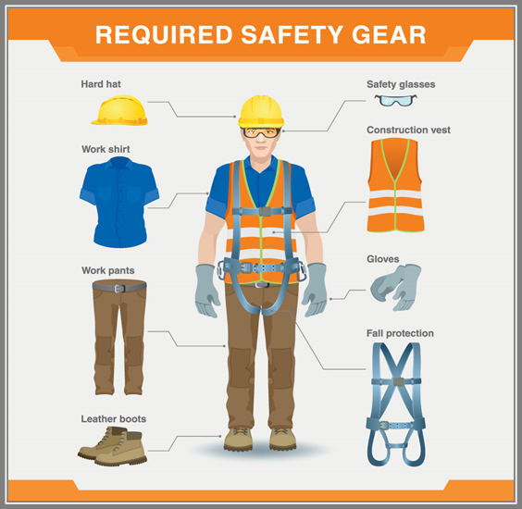
Community and Job Safety
People can receive advocacy training to:
Understand and assert their rights.
Develop the skills to advocate for themselves.
Protect themselves in the community.
Get advocacy services.
Job coaches may provide on-going work-site safety training including but not limited to work place hazard training, fire drills and other emergency drills.

Slide 50
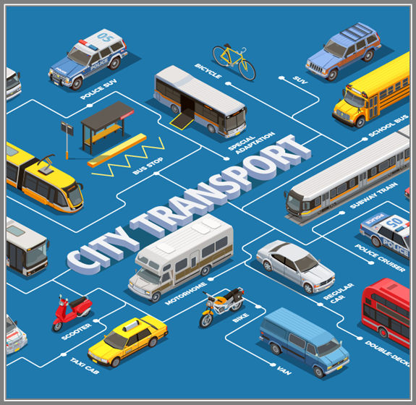
Transportation and Safety (1 of 2)
Public transportation includes: Bus, Light Rail, Train, Ferry, and Trolley.
Their websites have information about how to use their transportation and be safe.
Some may offer transportation training.
Transportation training may be available through either school supports, SE services, or regional center services.

Slide 51
Transportation and Safety (2 of 2)
Door to door public transportation includes: Paratransit, car pools, taxis, Uber, Lyft.
Natural supports include: A family member, friend, or hired driver who can drive a person to and from work.
Independent travel includes: a person’s own vehicle, riding their bike, or walking.
Some programs offer free bus passes and/or provide door to door transportation. Ask the program the individual is receiving services from if they have this service and if the person qualifies for this service.

Slide 52

Video and story links to CIE success stories
We encourage you look at the videos about CIE success stories and other videos about work for people with ID/DD. Links to these videos are on the CIE Webinar Fact Sheet.
The videos are inspiring and have some good information.

Slide 53
Other Resources that can help a person find CIE (1 of 2)
The California Employment Consortium for Youth and Young Adults with ID/DD (CECY). CECY has information on other ways students are transitioning from high school and into CIE.
Project Search programs give a person with ID/DD a chance to intern at a business or hospital for one year to learn employment skills to work at a business or hospital.

Slide 54
Other Resources to that can help a person find CIE (2 of 2)
The America’s Job Center of California (AJCC) is another place to learn job skills and find a job. AJCCs offer career planning, internships, job skills training job search support and more.
You can find more information about these resources on your CIE Webinar Glossary of Terms.

Slide 55
Questions?
If we do not have enough time to answer all questions today, you can email us at:
CaliforniaCIE@dor.ca.gov

Slide 56

Thank you
We have come to the end of the Pathways to “Real Work for Real Pay in the Real World” webinar
This webinar will be posted in English and in Spanish on the California Health and Human Services website CIE webpage which can be found on your CIE Webinar Glossary of Terms.
We encourage you to email us at the CaliforniaCIE@dor.ca.gov and tell us what you think of this webinar.
Thank you so much for joining us.

