Slide 1
California child welfare council
September 2, 2015

Slide 2
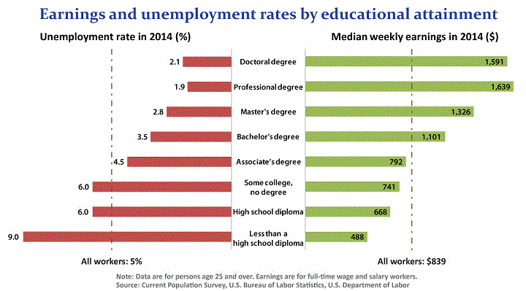
Education Pays
Notes:
When we extended care to college students we implicated college systems – focus can’t just be on minors anymore – child welfare is now serving college students
Why is education so important? Over a person’s lifetime the difference in income can add up to several hundred thousand dollars.
Fastest-growing industries such as health care, education, and business support services require a bachelor's degree or above.
Fewer options for those without college degrees now-and there will be even fewer in the future. Occupations losing the most jobs are clerks, cashiers, telemarketers, packagers, and farmers.
There's more competition for jobs that pay less and have less security.
Other benefits of higher ed
Lower incarceration rates
Improved health outcomes
Higher levels of civic participation, including volunteer work and voting
Children more likely to attend college
Have a vocation – meaningful work

Slide 3
Common agenda
Supporting foster youth to achieve four important milestones:

Slide 4
Strategic framework
Statewide initiative that includes community colleges, CSUs, UCs, private campuses and other partners to increase college access, retention & graduation for foster youth by:
Expanding College and Career Pathways
Strengthening Campus and Community Capacity
Promoting Data Informed Decision Making
Supporting Policy Development and Implementation
Engaging the Expertise of Foster Youth
Notes:
Technical Assistance to individual campuses
Training – webinars, newsletter, website
Policy – will address later
Foster Club is partner
Managed by JBF

Slide 5
California College Pathways Networks
1
2
3
Northern Network
Butte College
CSU Chico
Shasta College
North Bay Network
CSU Sonoma
Santa Rosa Junior College
Solano Community College
Bay Area Network
College of Marin
CSU San Francisco
1
4
6
5
Central Coast Network
Cabrillo College
CSU Monterey Bay
CSU San Jose
Hartnell College
UC Santa Cruz
Merced Network
Madera Community College Center
Merced College
UC Merced
San Fernando Valley Network
CSU Northridge
LA Mission College
LA Pierce College
LA Valley College
2
3
8
5
7
4
Los Angeles Network
LA City College
LA Trade Tech
University of Southern California
West LA College
West LA Network
Loyola Marymount University
Santa Monica College
UC Los Angeles
9
10
6
10
7
8
9
Orange County Network
CSU Fullerton
Golden West College
Orange Coast College
Riverside Network
Moreno Valley College
Riverside City College
UC Riverside
Notes:
10 networks – 33 campuses

Slide 6
CCP funding partners
Angell Foundation
California Wellness Foundation
Conrad C. Hilton Foundation
Mary And Stanley Smith Charitable Trust
Pritzker Foster Care Initiative
Resiliency Fund
Stuart Foundation
Tipping Point Foundation
Walter S. Johnson Foundation

Slide 7
highlights
Expansion of campus support programs. 9 UCs, 21 CSUs, 34 CCCs and 5 private universities
Maintaining college access. Obtained an exemption for foster youth from new BOG fee waiver and priority registration restrictions
Preserving financial aid. Obtained favorable federal guidance regarding the impact of AB12 income on financial aid
Targeting new funding. Inclusion of foster youth in community college equity planning requirements
Expanding support. Institutionalization of campus support at up to 10 community college districts beginning in 2016
Improving outcome tracking – Foster youth flag in CCC MIS and CalPASS Plus foster youth data dashboard
Notes:
Programs – why these programs are so essential
College access – discuss Student Success Initiative
Limitations of equity funding (FY not always included, inadequate data)
SB 1023 – important but also limited to 10 districts - $15 million allocation
Explain the data dashboard
Mention AB 592

Slide 8
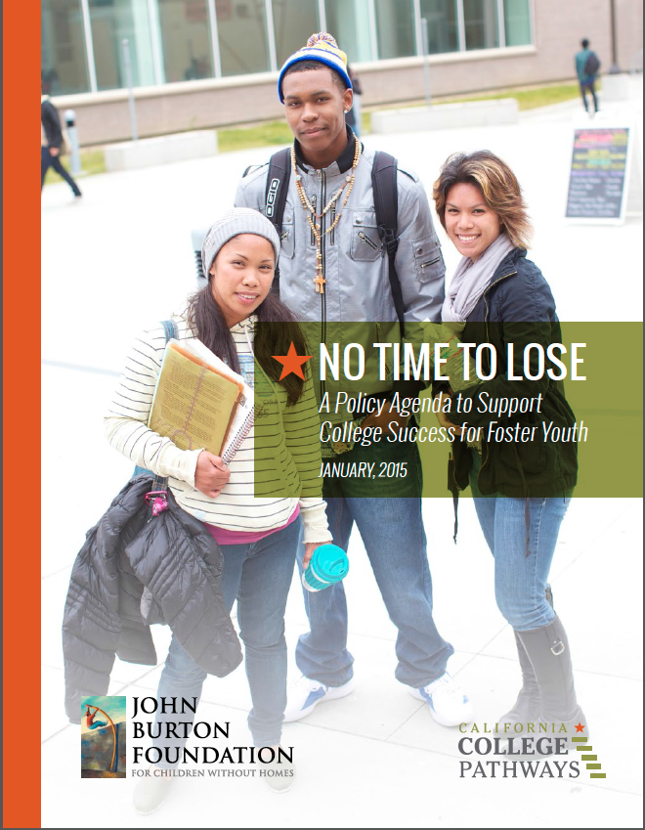
Publications
Notes:
Also mention one page overview

Slide 9
Forthcoming CCP report
Release: Fall 2015
Campuses included: 19 community colleges and 12 universities
Years: 2012-13 and 2013-14
Data sources: Cal-PASS Plus foster youth dashboards and individual campuses
Focus: Metrics highlight how foster youth are faring in post-secondary education
Resources accessed (e.g., financial aid, student support programs)
Achievement and gaps (e.g., GPA, course completion, persistence)
Notes:
Approximately 4800 students flagged as foster youth (current or former) included in community college data, 1100 in university data

Slide 10
Report highlights: Community colleges
Notes:
High percentages had their first course in one or more of these subjects at the remedial level, percentages particularly high for foster youth.

Slide 11
Report highlights: Community colleges
Notes:
Disparity in receipt rates, despite the fact that if student has financial need sufficient to qualify for BOG Fee waiver, it would likely qualify them for a Pell grant too. Possible reasons for disparity: 1) some foster youth may not filling out the FAFSA (confusing, daunting, etc.); and 2) some may be losing eligibility for Pell due to their grades. Disparity is important, because while BOG covers enrollment fees, it does not cover living expenses like housing, which Pell can cover.

Slide 12
Report highlights: Community colleges
Notes:
Foster youth less likely to achieve a 2.0 GPA for the academic year. First year students struggle even more

Slide 13
Report highlights: universities
Notes:
Data are for CSUs only. Need for remediation based on scores on the English Placement Test and Entry Level Mathematics Exam.

Slide 14
Report highlights: universities
Notes:
Foster youth achieving 2.0’s at high levels, not a large achievement gap. Achievement gap opens up at 3.0 level

Slide 15
Foster youth id - current
FAFSA
application
FY Support Program
Chafee Grant Roster
EOP/EOPS
College
Application
Priority Reg List
Notes:
Complicated and inconsistent

Slide 16
NEXT STEPS – DATA SHARING
Most community colleges identify foster youth for MIS solely through self report on college application – INACCURACIES ABOUND!
Data sharing between college systems and CWS/CMS would enable
More accurate tracking of foster youth college outcomes
Analysis of college participation for AB 12 participants
Better linkage to services
Removal of onerous verification requirements
Enhanced capacity to plan for needs of population
Notes:
CWC can play a role in moving this forward.
Given that they are adults who can provide consent, might this make data sharing easier?

Slide 17
For More Information
Debbie Raucher: debbie@johnburtonfoundation.org
Ken Sorey: ken@edresults.org
Christina Stearns: cstearns@rti.org
www.cacollegepathways.org
Notes:
Mention Blueprint and newsletter!!

